Slide 1
Virtual Reality Engine
apolol92

Slide 2
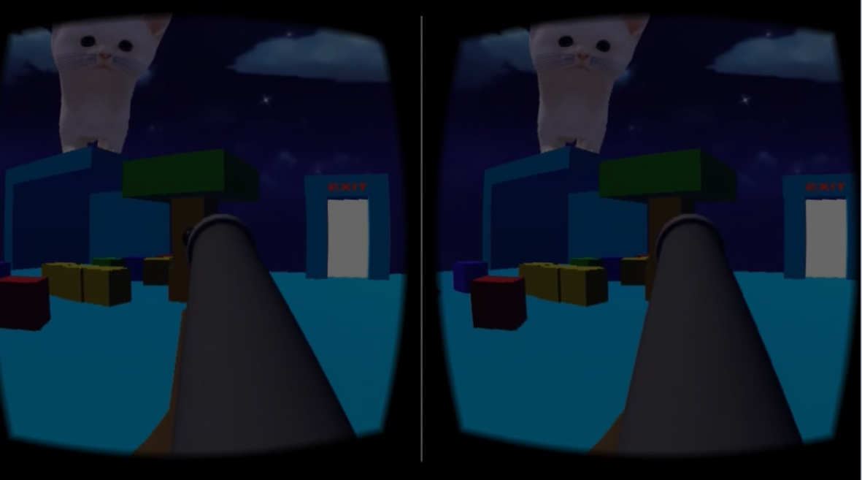
Approach
Google Cardboard
(0/0/0)
(x/y/z)
Use the webcam and the ping pong balls to determine user position in a 3D-Room.
Ping Pong Balls

Slide 3
Pros and Cons
Pros | Cons
+ Precise | - Webcam and Computer is needed
+ Very cheap | - Also a cap
+ More intuitive and „real“

Slide 4
This Approach vs Double Integration
This approach is more precise
This approach has got more possibilities to expand (track other bodyparts, objects in the room..)

